Slide 1


Analog IC Final Project Two Stage Operational Amplifier with a Constant-Gm Current Source
Christopher Williams, JT Crainer, Vishal Yadav, Pate Linker
Notes:
JT

Slide 2
Presentation Contents
Problem Statement
Amplifier
Design & Schematic
Current Source
Design & Symbol
Test bench & Layout
Constant-Gm Performance
Full Circuit Performance
Entire Layout & Schematic
Simulations & FOM Report
Conclusion
1
Notes:
JT

Slide 3
Problem Statement
We set out to design a self biasing operational amplifier that has a supply voltage in the range of 2.5 – 5 V, temperature range from -20 – 100 degrees C, a gain of > 65 dB, a total current draw < 100 µA @ 3.3 V, gain bandwidth > 200 MHz, slew rate > 150 V/µS, phase margin > 60 degrees, and the smallest chip area possible.
2
Notes:
Chris

Slide 4
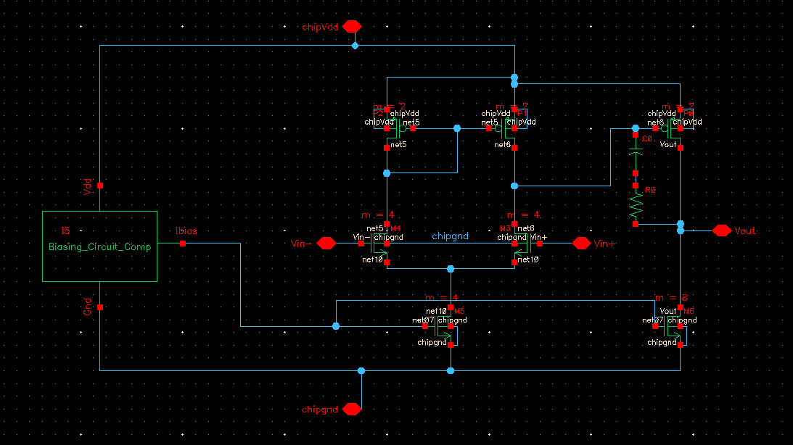
Amplifier
Schematic
3
Notes:
Chris

Slide 5
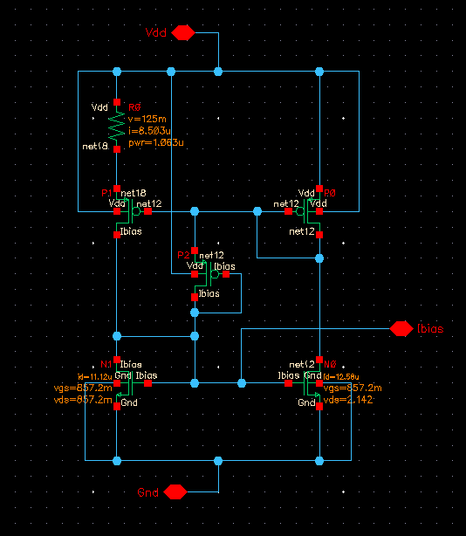
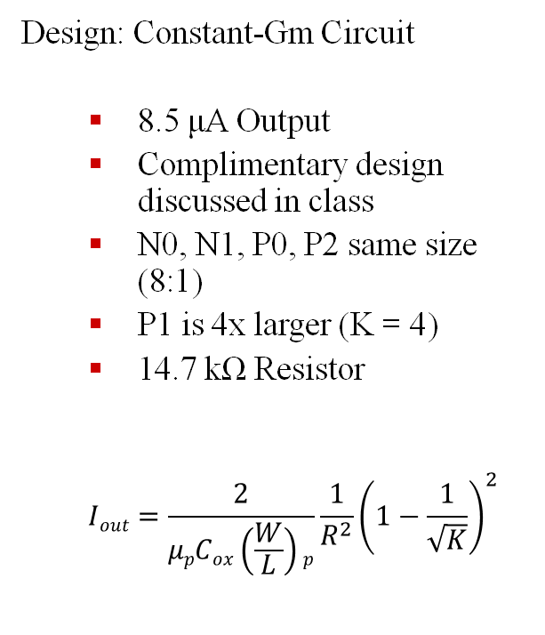
Current Source
Design: Constant-Gm Circuit
8.5 μA Output
Complimentary design discussed in class
N0, N1, P0, P2 same size (8:1)
P1 is 4x larger (K = 4)
14.7 kΩ Resistor
$$Iout=\frac{2}{μpCox\left(\frac{W}{L}\right)p}\frac{1}{R^{2}}{\left(1−\frac{1}{\sqrt{K}}\right)}^{2}$$
4
Notes:
JT

Slide 6
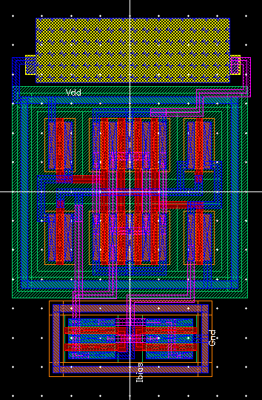
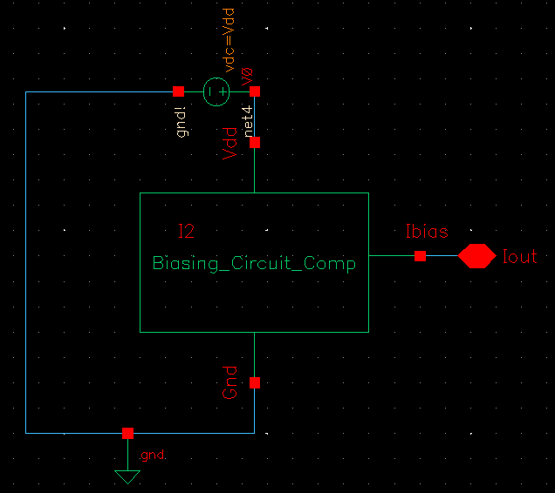

Current Source
Current Source layout
Resistor : 14.74 kΩ
Area : 2464.42 µ$m^{2}$
Constant-Gm Test-Bench
Vdd = 3.3 V
Ibias = 8.5 µA
5
Notes:
Vish

Slide 7
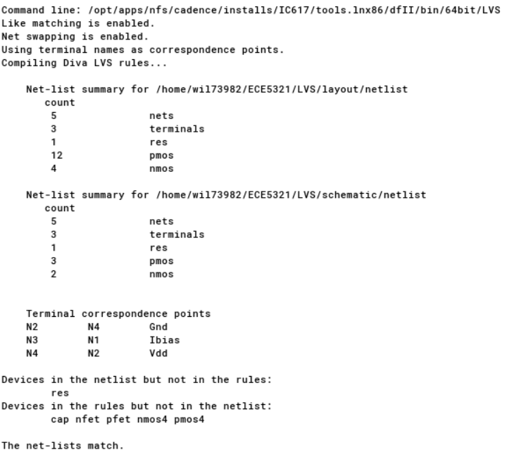
Constant-Gm Performance
LVS Report
6
Notes:
Vish

Slide 8
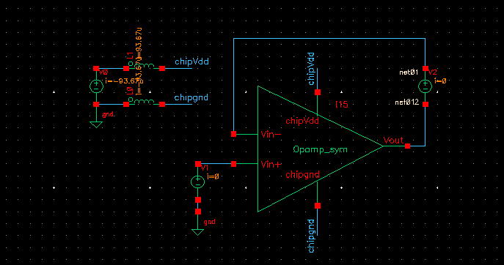
Full Circuit Performance
DC Power Bias
DC Power Parameters
Vdd | 3.3 V
Vin | 1.7 V
Ibias | 8.5 µA
7
Notes:
Chris

Slide 9
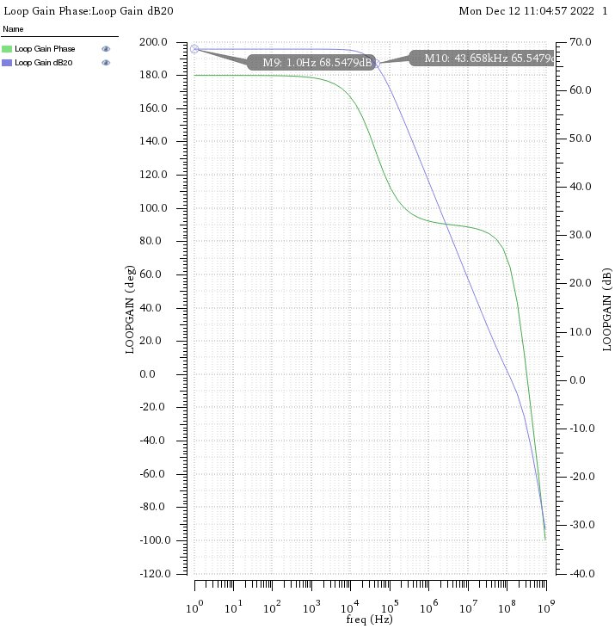
Full Circuit Performance
Gain Response
Nominal Component and Phase Margin
Cm | 245 fF
Rm | 10.5 kΩ
Phase | 60.93°
8
Notes:
Pate

Slide 10
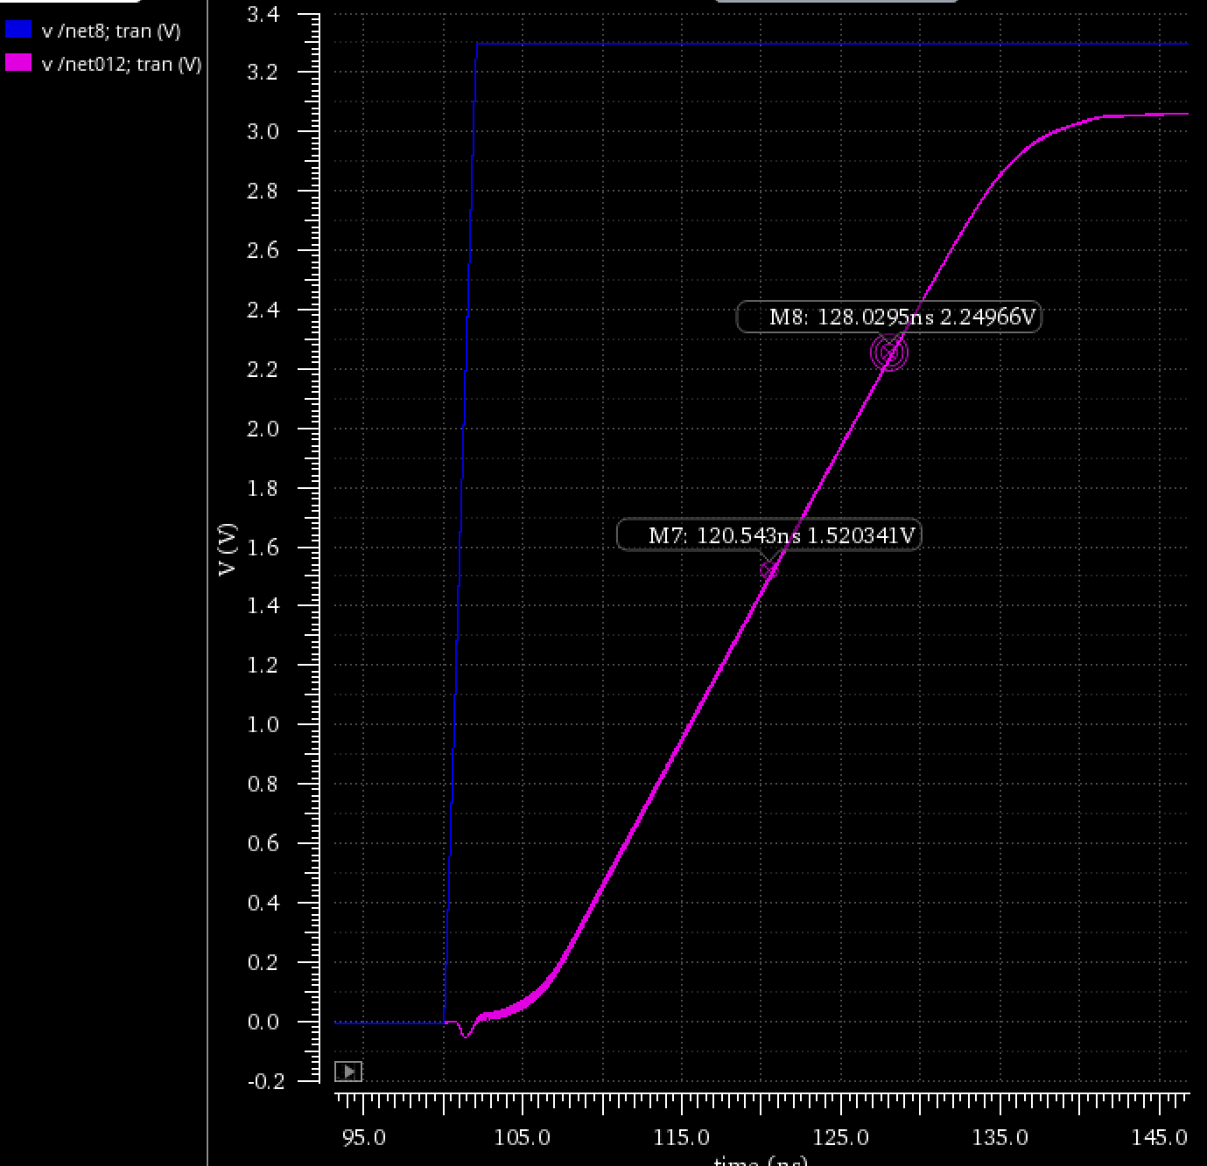
Full Circuit Performance
Slew Rate
SR = 97.418 V/uS
Blue: Vin
Pink: Vout
9
Notes:
Pate

Slide 11
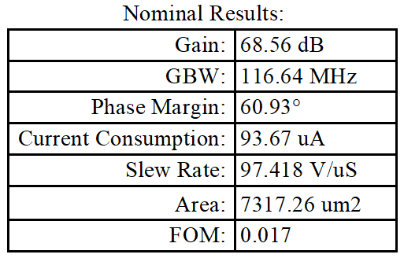
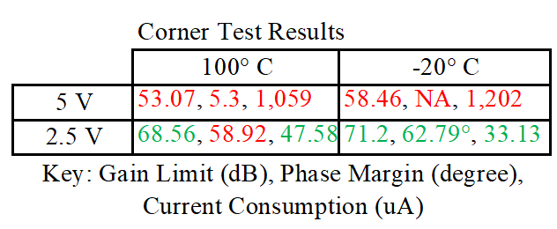
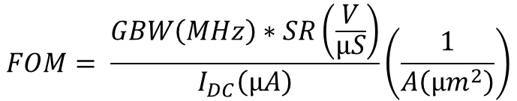
Full Circuit Performance
Simulation Results
$$FOM= \frac{GBW\left(MHz\right)∗SR\left(\frac{V}{µS}\right)}{I_{DC}\left(µA\right)}\left(\frac{1}{A\left(µm^{2}\right)}\right)$$
10
Notes:
Chris

Slide 12
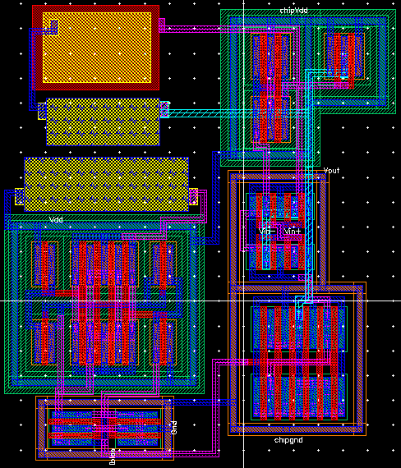
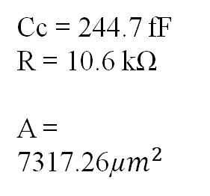
Full Circuit Performance
Full Layout
Cc = 244.7 fF
R = 10.6 kΩ
A = 7317.26µ$m^{2}$
11
Notes:
Pate

Slide 13
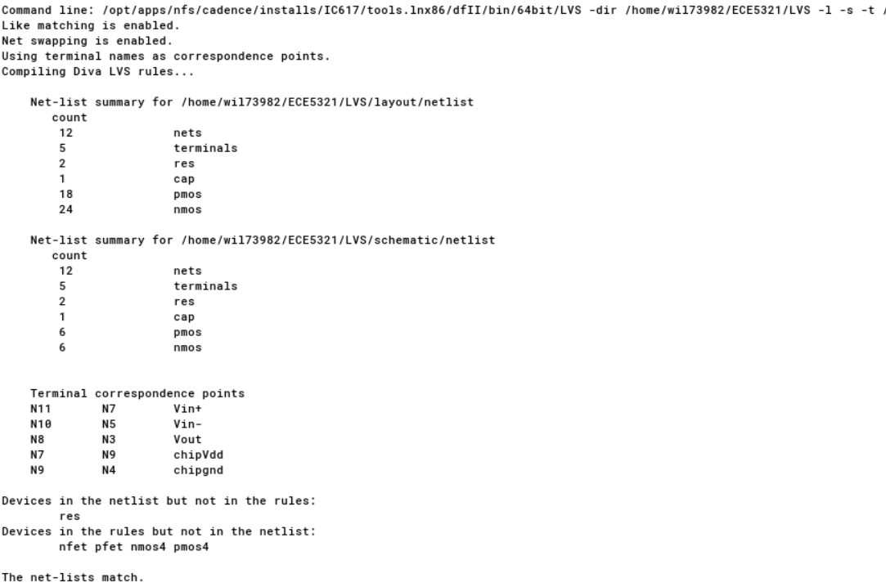
Full Circuit Performance
LVS Report
12
Notes:
Pate

Slide 14
References
In Class Notes, Dr. Changzhi Li, ECE5321, 2022
Behzad Razavi, Design of analog CMOS integrated circuits. New York, Ny: Mcgraw-Hill Education, 2017
13
Notes:
Pate

Slide 15


Slide 16
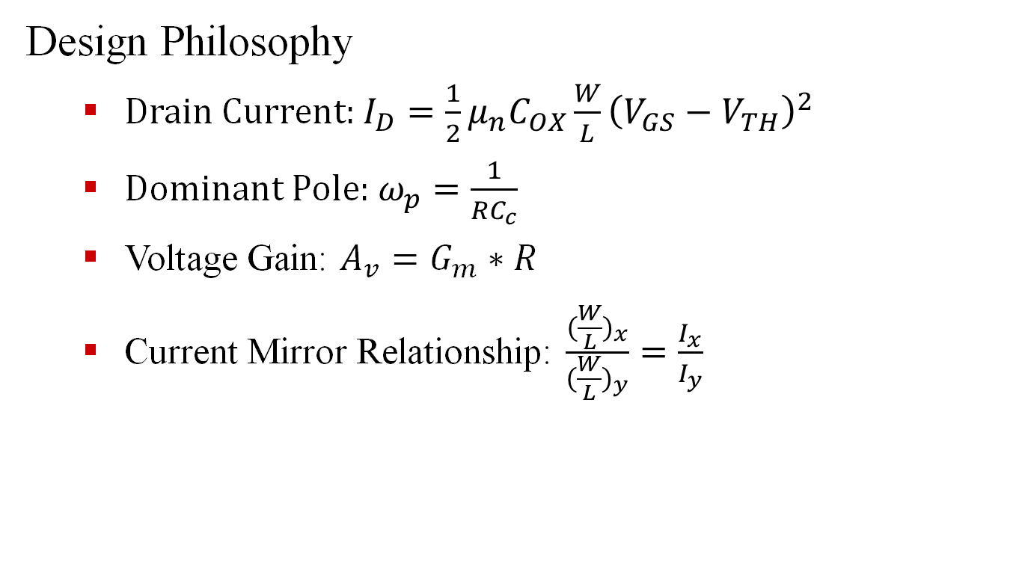
Amplifier
Design Philosophy
Drain Current: $I_{D}=\frac{1}{2}μ_{n}C_{OX}\frac{W}{L}{\left(V_{GS}−V_{TH}\right)}^{2}$
Dominant Pole: $ω_{p}=\frac{1}{RC_{c}}$
Voltage Gain: $A_{v}=G_{m}∗R$
Current Mirror Relationship: $\frac{{(\frac{W}{L})}_{x}}{{(\frac{W}{L})}_{y}}=\frac{I_{x}}{I_{y}}$

